Slide 1
COMP 4500
Week 11 - Friday

Slide 2
Last time
What did we talk about last time?
Bipartite matching

Slide 3
Questions?

Slide 4

Logical warmup
Two vegetarians and two cannibals are on one bank of a river
They have a boat that can hold at most two people
Come up with a sequence of boat loads that will convey all four people safely to the other side of the river
The cannibals on any given bank cannot outnumber the vegetarians…or else!

Slide 5
NP-completeness

Slide 6
Efficient algorithms
Until this point in the course, we have studied efficient algorithms
  Polynomial time algorithms
Perhaps more important than the list of algorithms we studied were the principles behind such algorithms
Are there problems for which there are no efficient algorithms?
The study of computational complexity tries to rank all problems based on their difficulty

Slide 7
Hard problems
Some very hard problems have been proven to have no polynomial-time algorithms
Unfortunately, a large number of important problems in optimization, AI, combinatorics, logic, and other areas have resisted categorization
  We have not been able to find polynomial-time algorithms for these problems
  But we have also failed to prove that polynomial time algorithms cannot exist

Slide 8
NP-complete
NP-complete problems are one of the classes in this gray area
All NP-complete problems are essentially equivalent because a polynomial-time algorithm for one such problem would imply a polynomial-time algorithm for all of them
Thus, we can think of this set of thousands of problems as really one fundamental problem

Slide 9
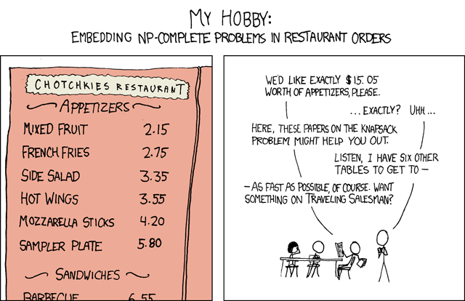
From xkcd: https://xkcd.com/287/

Slide 10
What happens when you need to solve an NP-complete problem?
Sometimes, very small instances or very constrained instances of NP-complete problems are solvable
Otherwise, we believe that NP-complete problems are computationally infeasible to solve, even though we can't prove it
Why look for an efficient algorithm for a problem when no one can find an efficient one for all these famous problems?

Slide 11
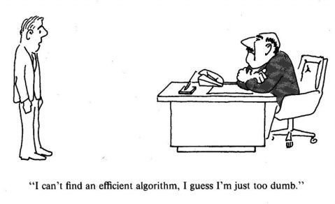

Slide 12
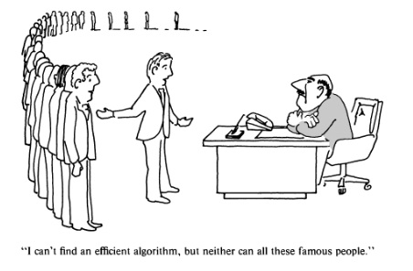

Slide 13
Three-Sentence Summary of Polynomial-Time Reductions

Slide 14
Polynomial-Time Reductions

Slide 15
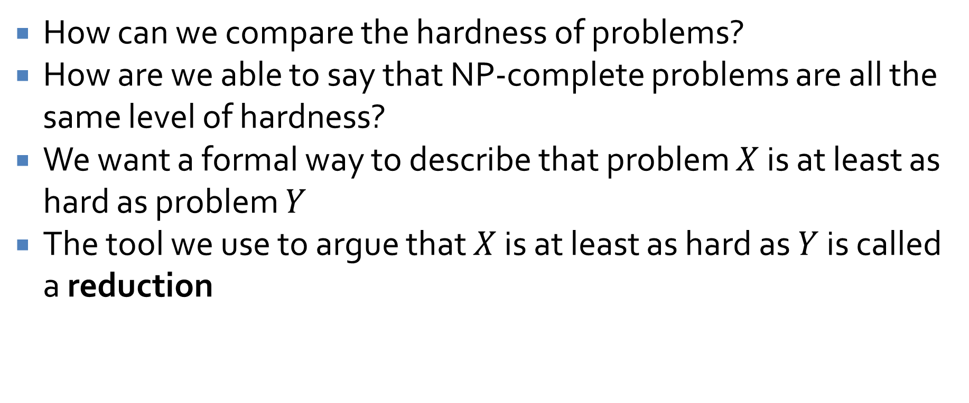
Characterizing hardness
How can we compare the hardness of problems?
How are we able to say that NP-complete problems are all the same level of hardness?
We want a formal way to describe that problem $X$ is at least as hard as problem $Y$
The tool we use to argue that $X$ is at least as hard as $Y$ is called a reduction

Slide 16
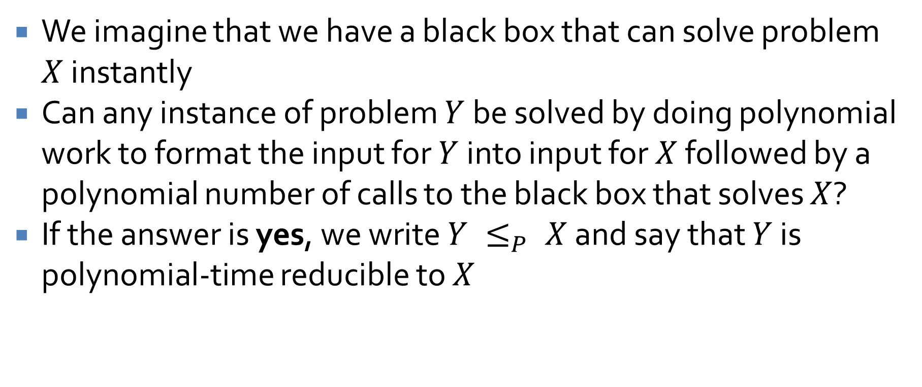
Reductions
We imagine that we have a black box that can solve problem $X$ instantly
Can any instance of problem $Y$ be solved by doing polynomial work to format the input for $Y$ into input for $X$ followed by a polynomial number of calls to the black box that solves $X$?
If the answer is yes, we write $Y ≤_{P} X$ and say that $Y$ is polynomial-time reducible to $X$

Slide 17
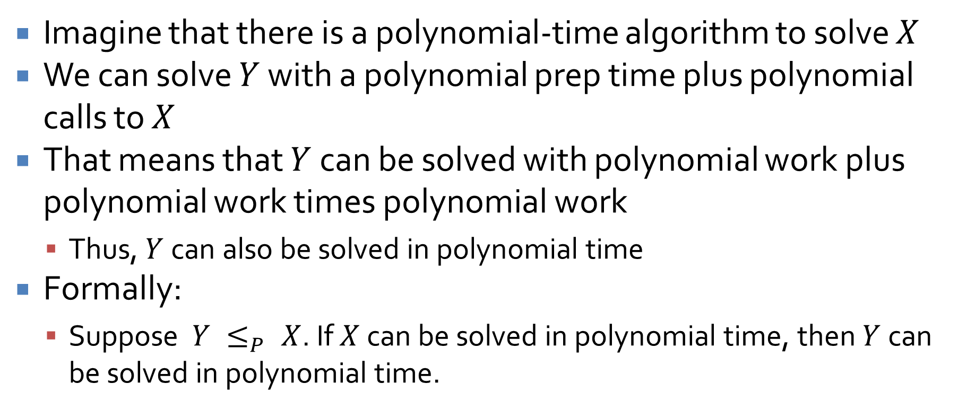
Why are reductions useful?
Imagine that there is a polynomial-time algorithm to solve $X$
We can solve $Y$ with a polynomial prep time plus polynomial calls to $X$
That means that $Y$ can be solved with polynomial work plus polynomial work times polynomial work
  Thus, $Y$ can also be solved in polynomial time
Formally:
  Suppose $Y ≤_{P} X$. If $X$ can be solved in polynomial time, then $Y$ can be solved in polynomial time.

Slide 18
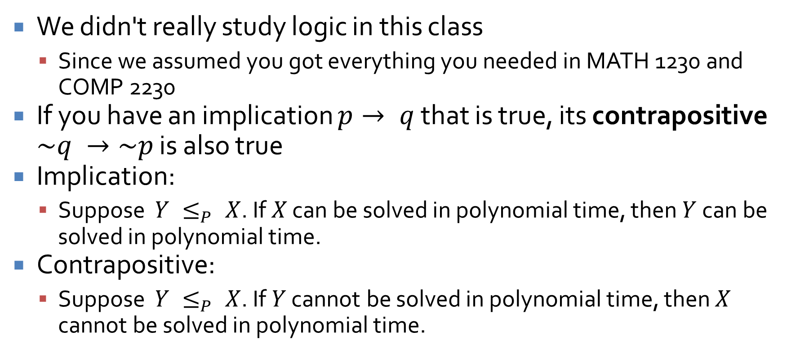
What about the other direction?
We didn't really study logic in this class
  Since we assumed you got everything you needed in MATH 1230 and COMP 2230
If you have an implication $p→ q$ that is true, its contrapositive $\sim q →\sim p$ is also true
Implication:
  Suppose $Y ≤_{P} X$. If $X$ can be solved in polynomial time, then $Y$ can be solved in polynomial time.
Contrapositive:
  Suppose $Y ≤_{P} X$. If $Y$ cannot be solved in polynomial time, then $X$ cannot be solved in polynomial time.

Slide 19
A house of cards
Reductions are not one tool in our arsenal …
  They're pretty much our only tool for comparing the difficulty of problems
If you can solve a problem with a polynomial-time algorithm, you know it's polynomial
For NP-complete problems (and even some higher classes), we have no way of being sure
All we can do is say that one problem is at least as hard as another

Slide 20
Independent set
Recall the independent set graph problem
Given an undirected graph, find the largest collection of nodes that are not connected to each other
Practical application:
  Nodes represent friends of yours
  An edge between those two nodes means they hate each other
  What's the largest group of friends you could invite to a party if you don't want any to hate each other?

Slide 21
Independent set example
A
G
B
H
E
F
C
D

Slide 22
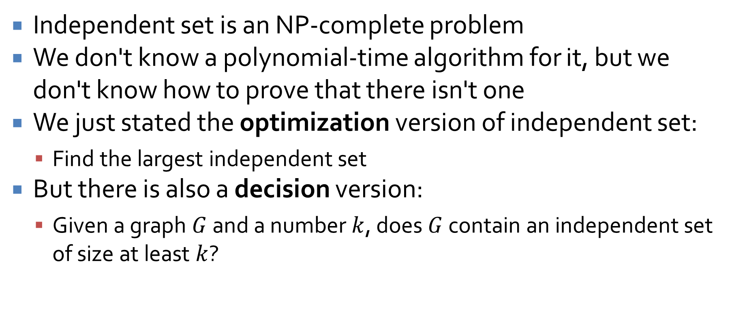
Hardness of independent set
Independent set is an NP-complete problem
We don't know a polynomial-time algorithm for it, but we don't know how to prove that there isn't one
We just stated the optimization version of independent set:
  Find the largest independent set
But there is also a decision version:
  Given a graph $G$ and a number $k$, does $G$ contain an independent set of size at least $k$?

Slide 23
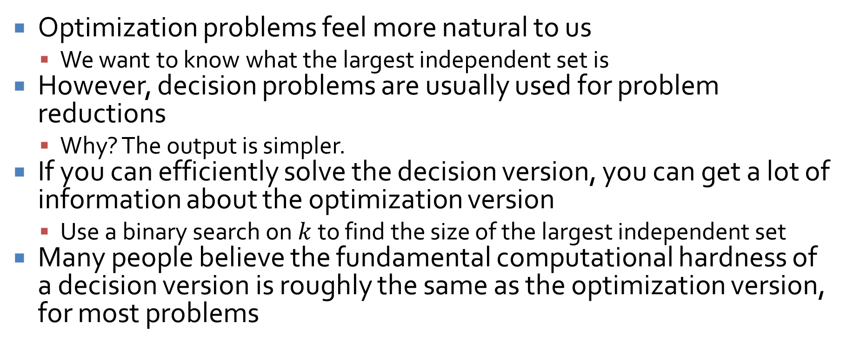
Optimization vs. decision problems
Optimization problems feel more natural to us
  We want to know what the largest independent set is
However, decision problems are usually used for problem reductions
  Why? The output is simpler.
If you can efficiently solve the decision version, you can get a lot of information about the optimization version
  Use a binary search on $k$ to find the size of the largest independent set
Many people believe the fundamental computational hardness of a decision version is roughly the same as the optimization version, for most problems

Slide 24
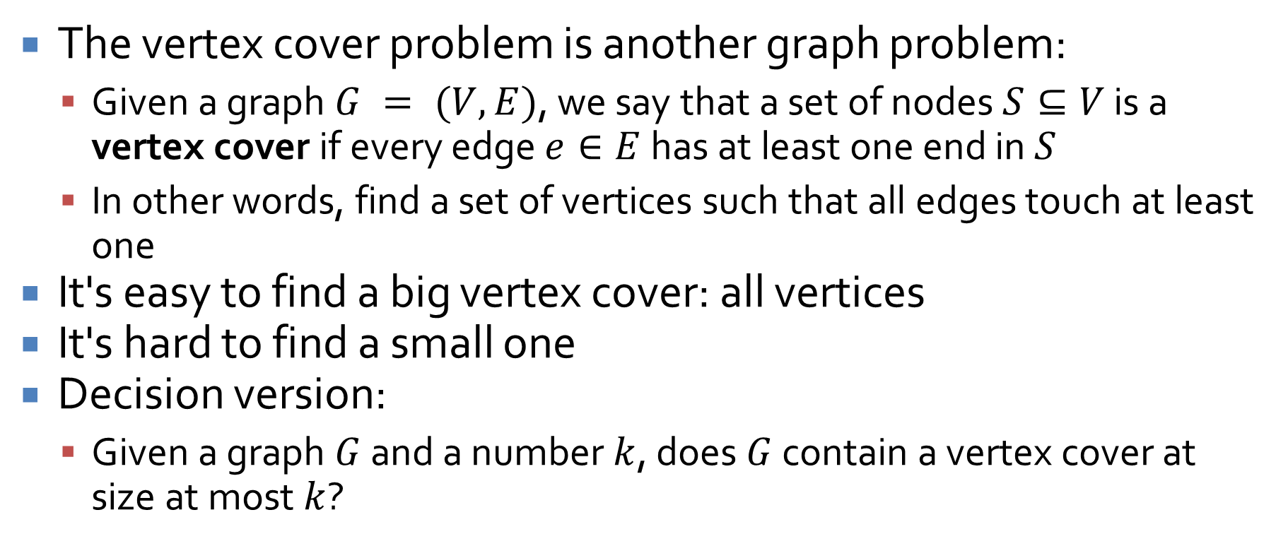
Vertex cover
The vertex cover problem is another graph problem:
  Given a graph $G = (V, E)$, we say that a set of nodes $S⊆V$ is a vertex cover if every edge $e∈E$ has at least one end in $S$
  In other words, find a set of vertices such that all edges touch at least one
It's easy to find a big vertex cover: all vertices
It's hard to find a small one
Decision version:
  Given a graph $G$ and a number $k$, does $G$ contain a vertex cover at size at most $k$?

Slide 25
Find a small vertex cover on this graph
A
G
B
H
E
F
C
D

Slide 26
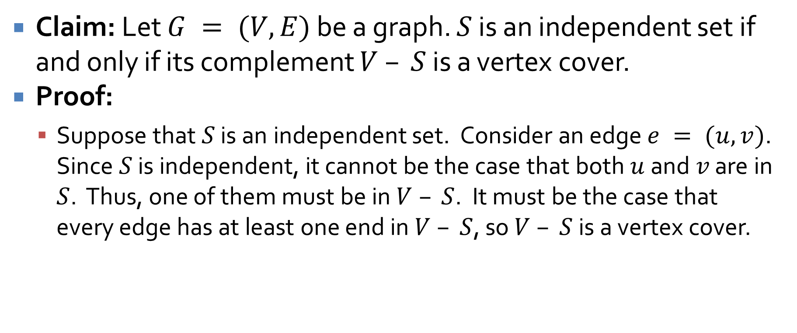
Relationship between independent set and vertex cover
Claim: Let $G = (V,E)$ be a graph. $S$ is an independent set if and only if its complement $V – S$ is a vertex cover.
Proof:
  Suppose that $S$ is an independent set. Consider an edge $e = (u,v)$. Since $S$ is independent, it cannot be the case that both $u$ and $v$ are in $S$. Thus, one of them must be in $V – S$. It must be the case that every edge has at least one end in $V – S$, so $V – S$ is a vertex cover.

Slide 27
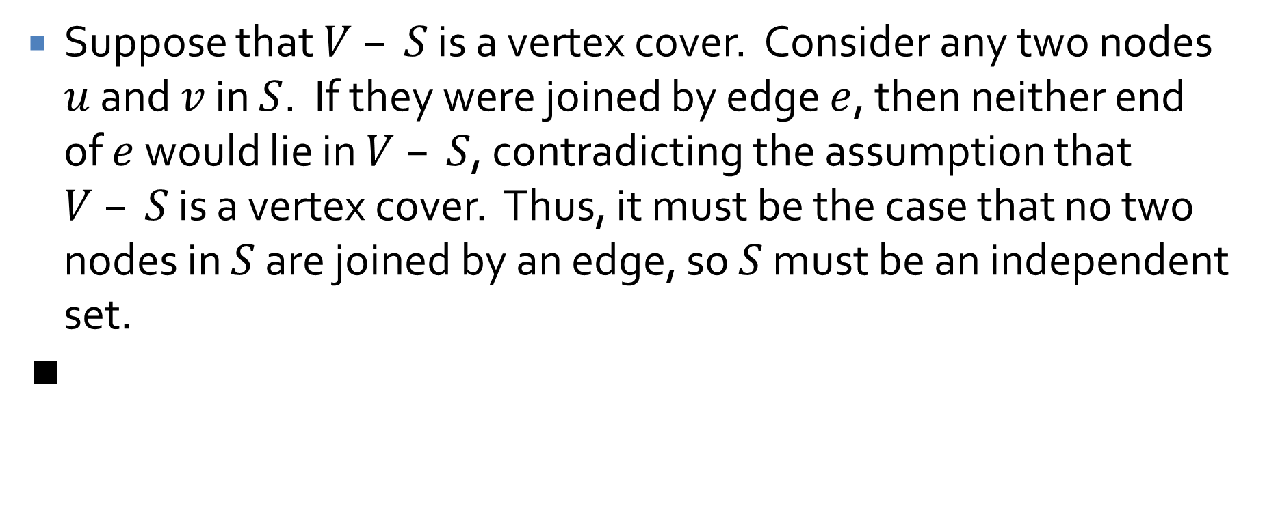
Proof continued
Suppose that $V – S$ is a vertex cover. Consider any two nodes $u$ and $v$ in $S$. If they were joined by edge $e$, then neither end of $e$ would lie in $V – S$, contradicting the assumption that $V – S$ is a vertex cover. Thus, it must be the case that no two nodes in $S$ are joined by an edge, so $S$ must be an independent set.
∎

Slide 28
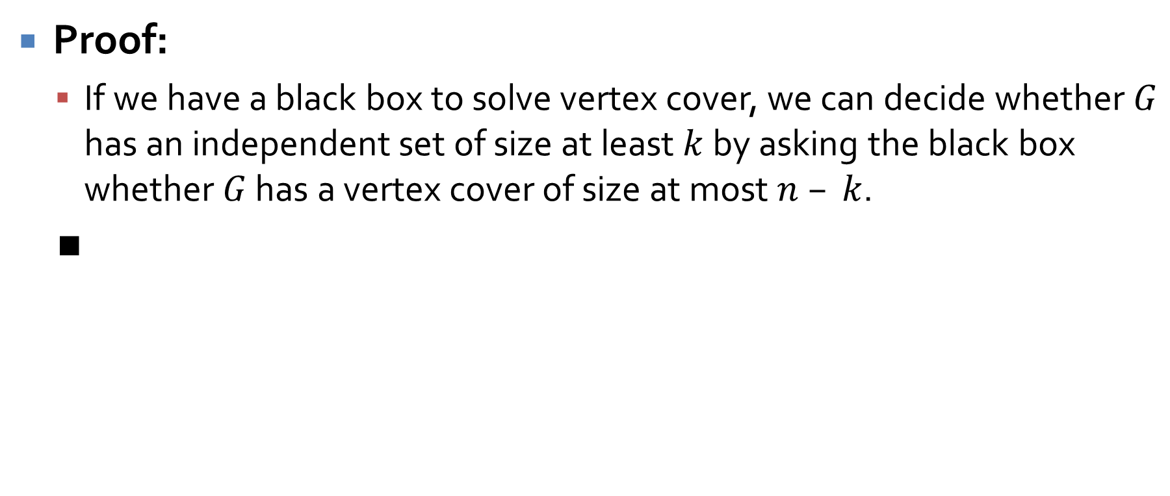

Independent set $≤_{P}$ vertex cover
Proof:
  If we have a black box to solve vertex cover, we can decide whether $G$ has an independent set of size at least $k$ by asking the black box whether $G$ has a vertex cover of size at most $n – k$.
  ∎

Slide 29
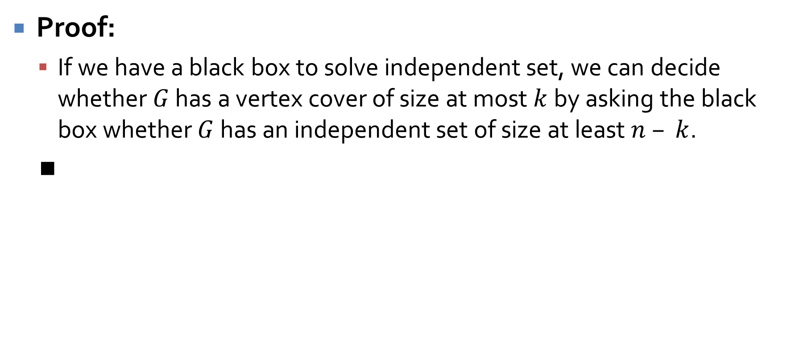

Vertex cover $≤_{P}$ independent set
Proof:
  If we have a black box to solve independent set, we can decide whether $G$ has a vertex cover of size at most $k$ by asking the black box whether $G$ has an independent set of size at least $n – k$.
  ∎

Slide 30
Reductions
We don't have an efficient algorithm for either independent set or vertex cover
Even so, we know that they are both approximately as hard as each other
These two problems are so closely related that it seems like this kind of reduction might not be generally applicable
However, the entire class of NP-complete problems are all reducible to each other, so it's a pretty general technique

Slide 31
Packing and covering
Independent set is a packing problem
  We want to pack in as many things as possible, subject to constraints
Vertex cover is a covering problem
  We want to cover everything (edges, in this case) with the smallest number of things (vertices in this case)
There are many NP-complete problems that fall into categories of packing and covering problems

Slide 32
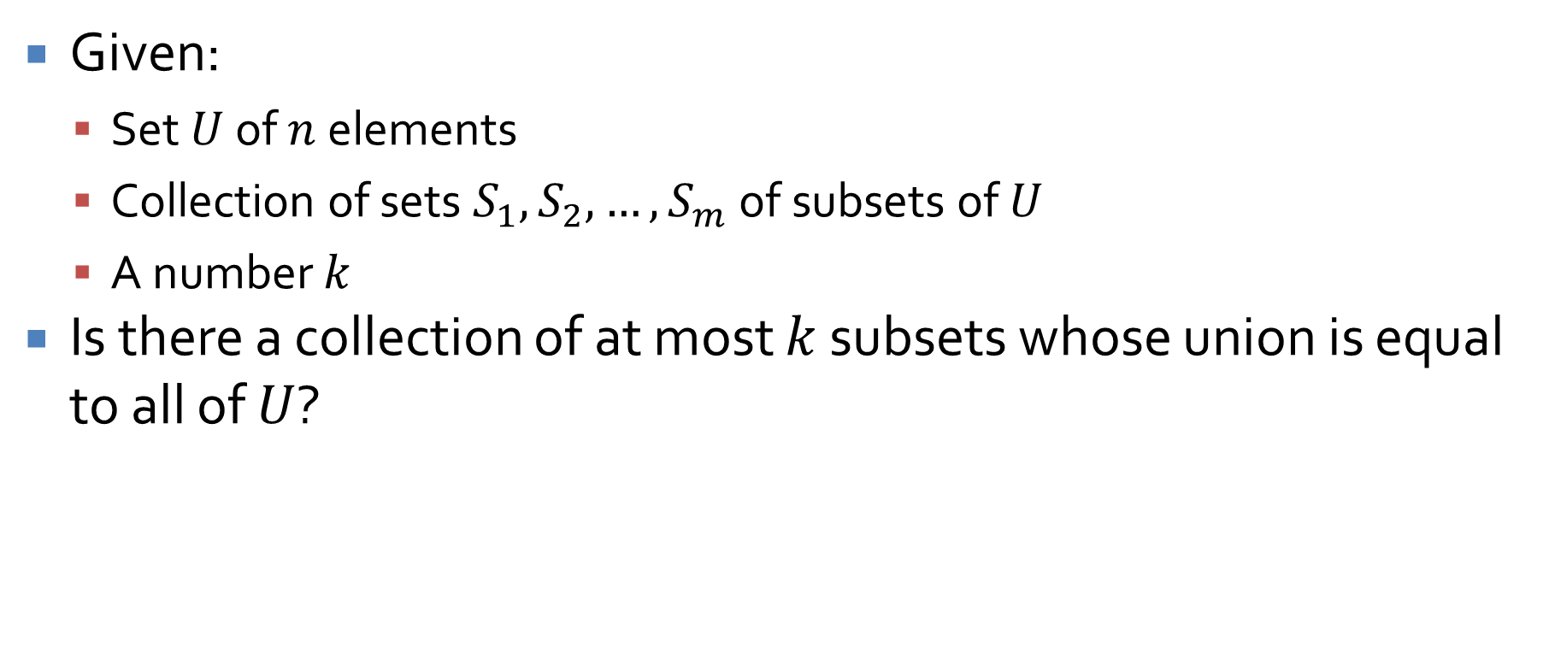
Set cover
Given:
  Set $U$ of $n$ elements
  Collection of sets $S_{1}, S_{2},…, S_{m}$ of subsets of $U$
  A number $k$
Is there a collection of at most $k$ subsets whose union is equal to all of $U$?

Slide 33







Set cover example
$$S_{6}$$
$$S_{1}$$
$$S_{3}$$
$$S_{4}$$
$$S_{5}$$
$$S_{2}$$
$$S_{7}$$

Slide 34
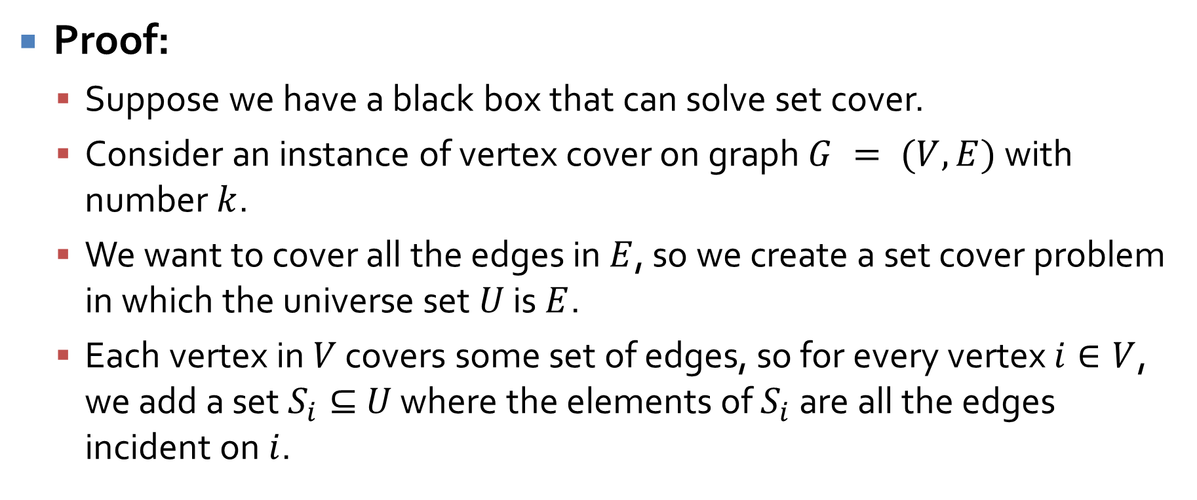
Vertex cover ≤_{P} set cover
Proof:
  Suppose we have a black box that can solve set cover.
  Consider an instance of vertex cover on graph $G = (V, E)$ with number $k$.
  We want to cover all the edges in $E$, so we create a set cover problem in which the universe set $U$ is $E$.
  Each vertex in $V$ covers some set of edges, so for every vertex $i∈V$, we add a set $S_{i}⊆$ $U$ where the elements of $S_{i}$ are all the edges incident on $i$.

Slide 35
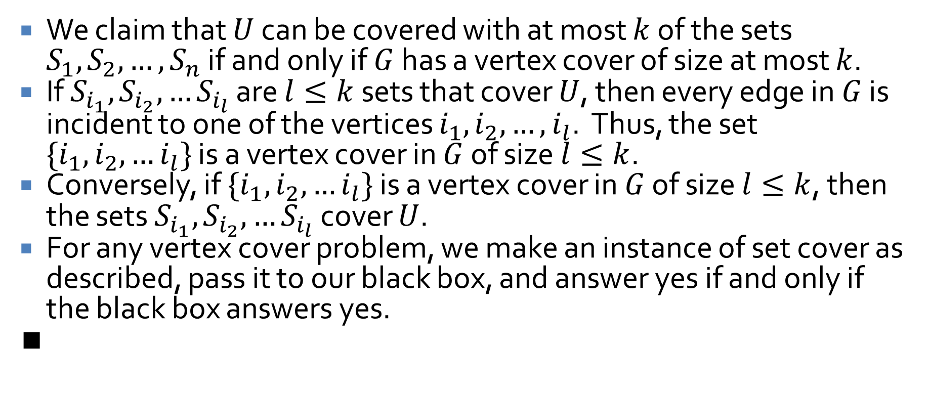
Proof continued
We claim that $U$ can be covered with at most $k$ of the sets $S_{1}, S_{2}, …, S_{n}$ if and only if $G$ has a vertex cover of size at most $k$.
If $S_{i_{1}},S_{i_{2}},…S_{i_{l}}$ are $l≤k$ sets that cover $U$, then every edge in $G$ is incident to one of the vertices $i_{1}, i_{2},…, i_{l}$. Thus, the set $\{{i_{1},i}_{2}, …i_{l}\}$ is a vertex cover in $G$ of size $l≤k$.
Conversely, if $\{{i_{1},i}_{2}, …i_{l}\}$ is a vertex cover in $G$ of size $l≤k$, then the sets $S_{i_{1}},S_{i_{2}},…S_{i_{l}}$ cover $U$.
For any vertex cover problem, we make an instance of set cover as described, pass it to our black box, and answer yes if and only if the black box answers yes.
∎

Slide 36
Upcoming

Slide 37
Next time…
Reductions via gadgets
Certificates and the definition of NP

Slide 38
Reminders
Finish Homework 5
  Due tonight by midnight!
Read 8.2 and 8.3
Study for Exam 3
  Monday after next!

